Slide 1
Predictive Maintenance
By
Oleg Makarovskiy

Slide 2
The Problem:
Unexpected machine failures casing expensive equipment downtime
Notes:
It’s no great discovery that water flows into itself. The issues of one part of the harbor are not entirely isolated from the issues of another. By better understanding how this water quality network works, water quality issues can be treated systematically rather than on a case by case basis.
Understanding the system requires constant and broad monitoring which is costly and time consuming.

Slide 3
The Solution:
Timely machine failure prediction to minimize production process downtime
Notes:
My proposed solution is to use geospatial statistics, network analysis, and machine learning to reduce monitoring costs without sacrificing accuracy
I looked at Chlorophyll A because it signals harmful algae blooms that can cause cascading effects damaging the natural ecosystem and public health alike

Slide 4
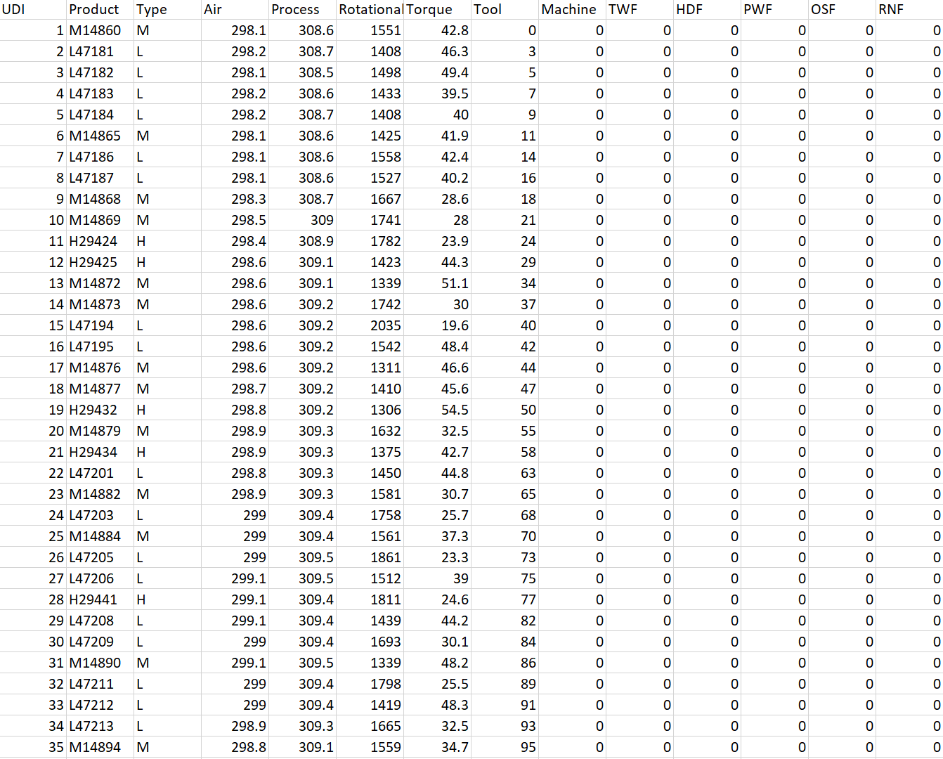
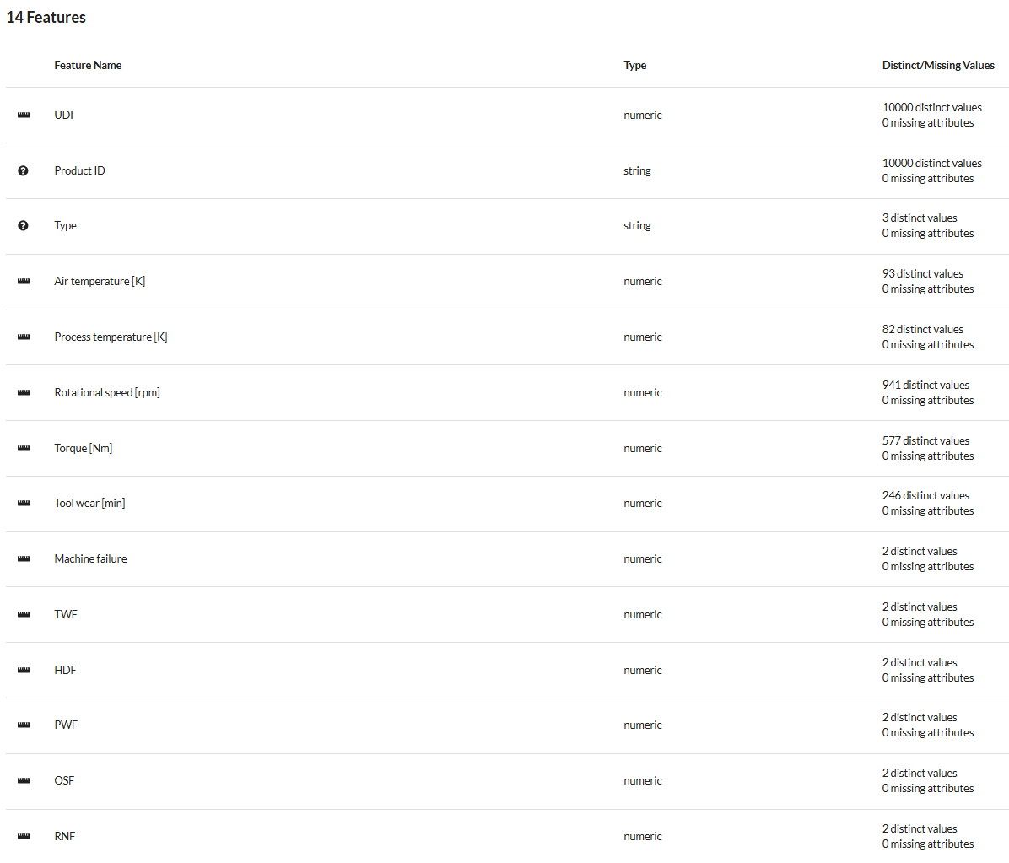
The Data
10000 distinct values
14 features
5 types of failure
5 process parameters
Data Source: https://www.openml.org/search?type=data&sort=runs&id=42890&status=active
Notes:
Dataset was 88,000 rows and 100 columns
Measurements from 1909
250 total sites

Slide 5
Data Wrangling
Original dataset had 10000 rows
and 14 columns
Analyze data distribution
Analyze dependencies
Drop redundant columns
Target Variable: Machine (Failure)
Notes:
Wanted a large enough time span to capture multiple climate anomalies
Wanted to focus on sites actively being sampled
Reduced the size and scope considerably by dumping redundant data
Imputed values based on old measurements
Chose chlorphyll as my target vairable because it has far reaching and tangible, immediate effects on an ecosystem such as fish death and drops in dissolved oxygen

Slide 6
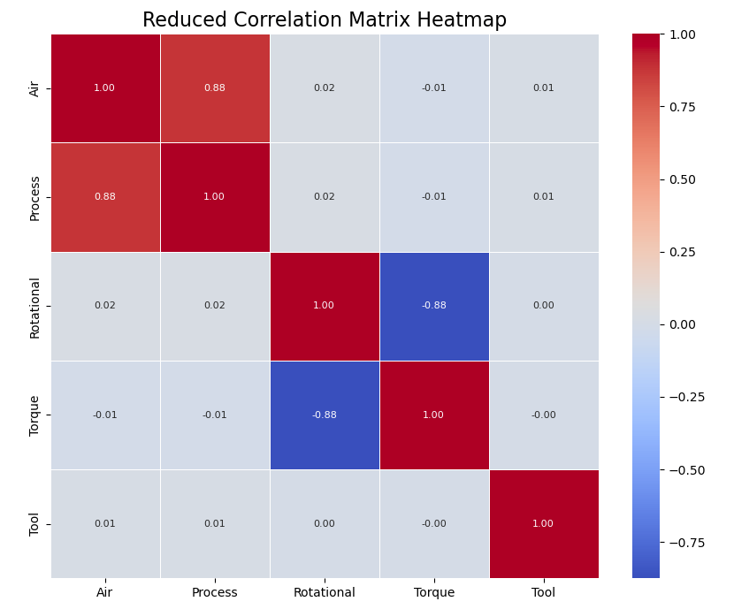
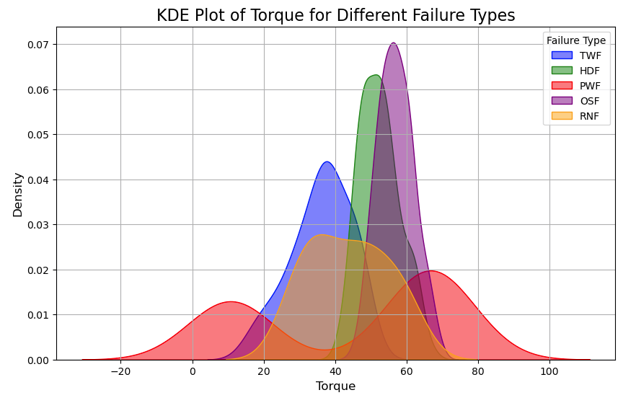
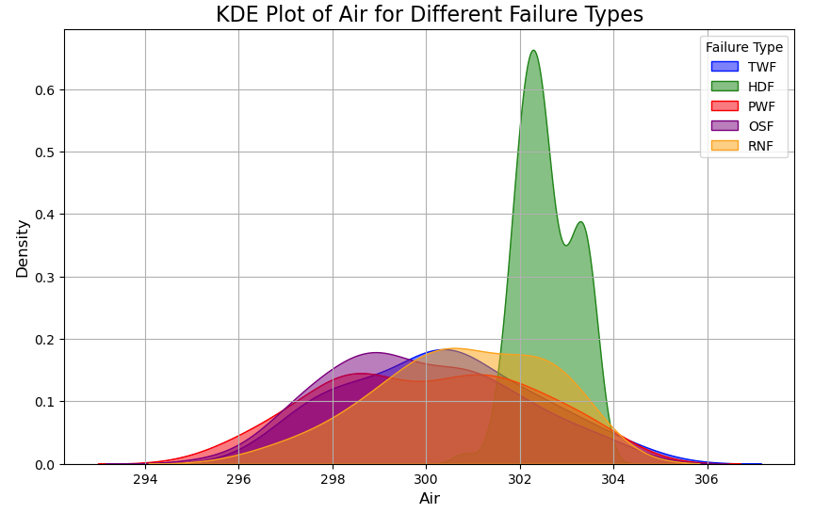
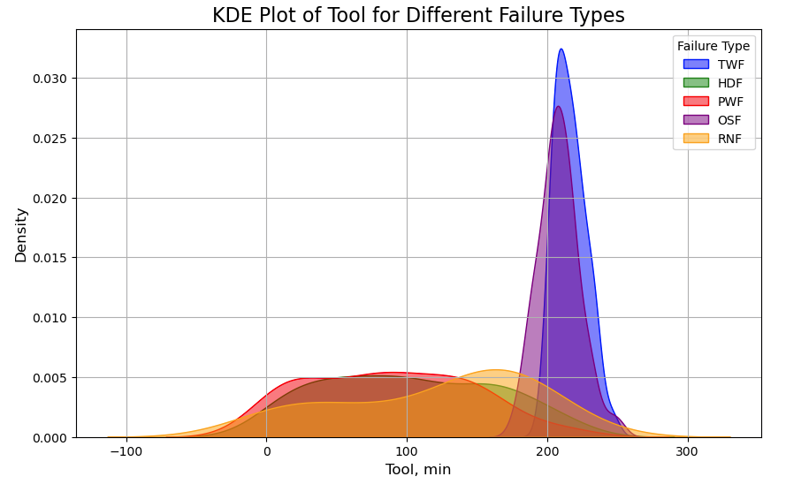
Exploratory Data Analysis
Notes:
Wanted a large enough time span to capture multiple climate anomalies
Wanted to focus on sites actively being sampled
Reduced the size and scope considerably by dumping redundant data
Imputed values based on old measurements
Chose chlorphyll as my target vairable because it has far reaching and tangible, immediate effects on an ecosystem such as fish death and drops in dissolved oxygen

Slide 7
Model Selection
Logistic Regression
Random Forest Classifier
KNN
DecisionTree

Slide 8
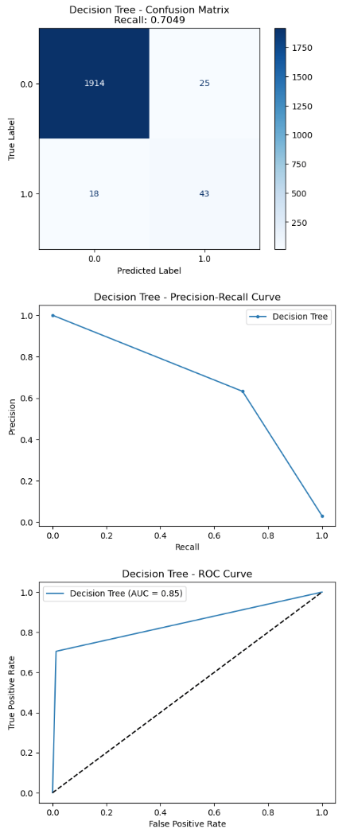
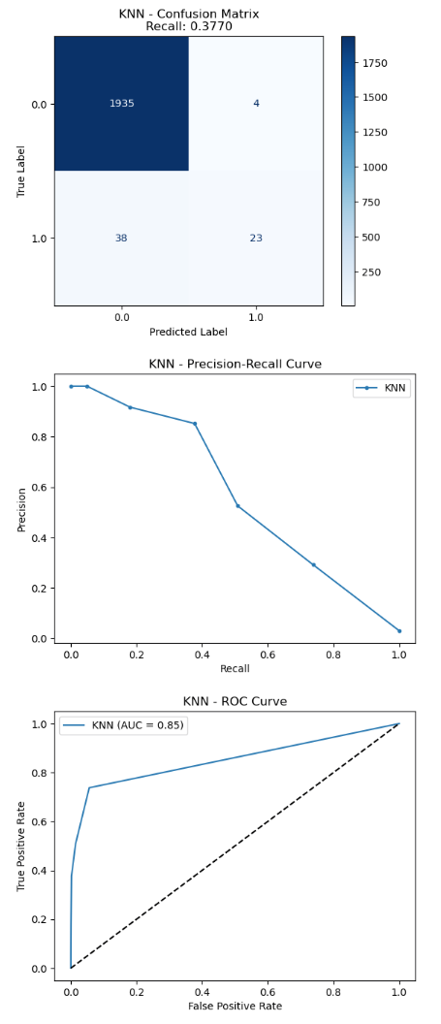
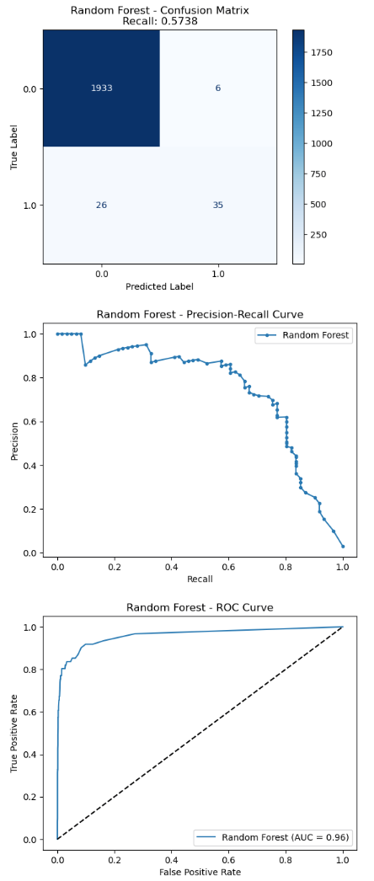
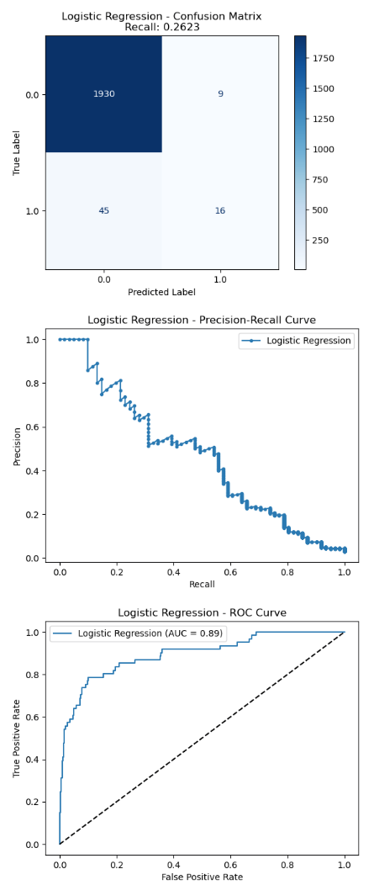
Models Comparison: Precision Recall
Decision Tree
KNN
Random Forest
Logistic Regression
Decision Tree - Test Recall: 0.7377
KNN - Test Recall: 0.3770
Random Forest - Test Recall: 0.5738
Logistic Regression - Test Recall: 0.2623
Notes:
Here are the precision recall curves for two distinct sites.
The one on the left is one with good predicatability and the one on the right is one with poor.
I looked at 6 sites and found 3 with good predictability. Those are the ones that I developed models for.

Slide 9
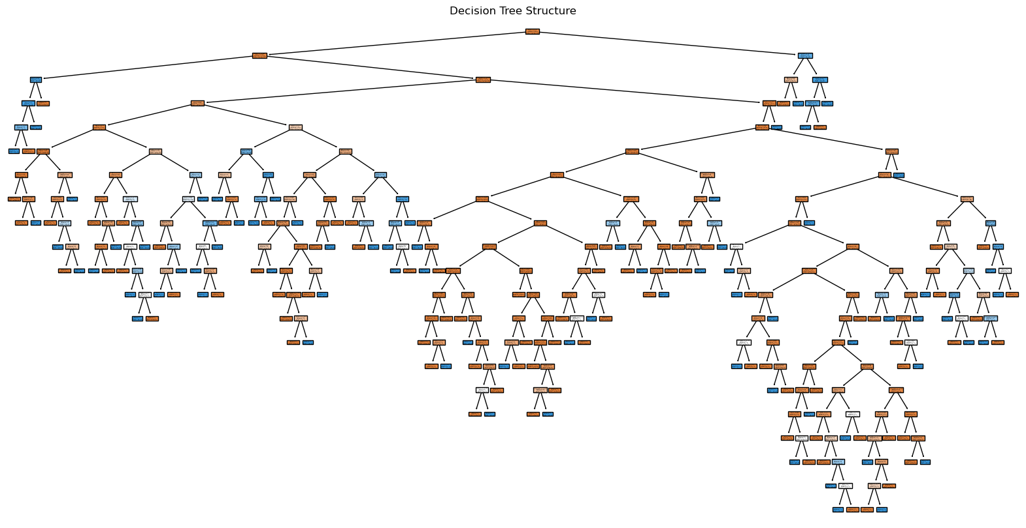
Notes:
When tuning my parameters, I used Grid Search Cross Validation
The m

Slide 10
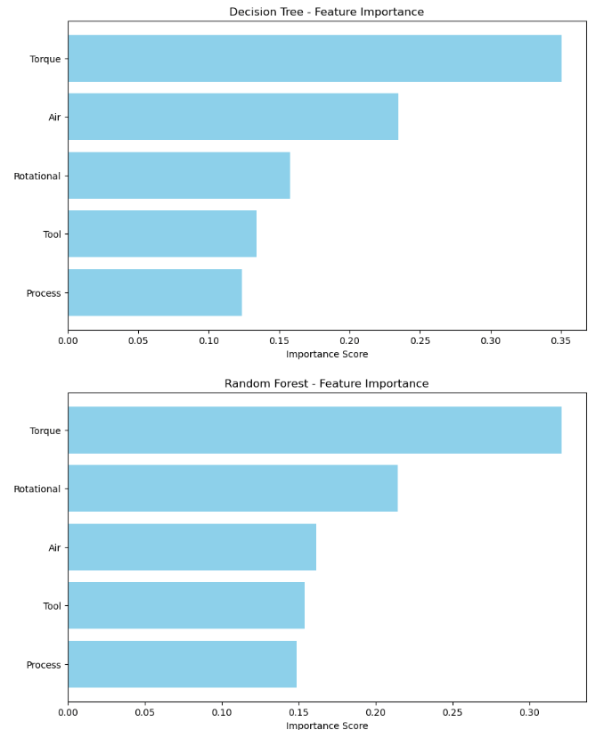
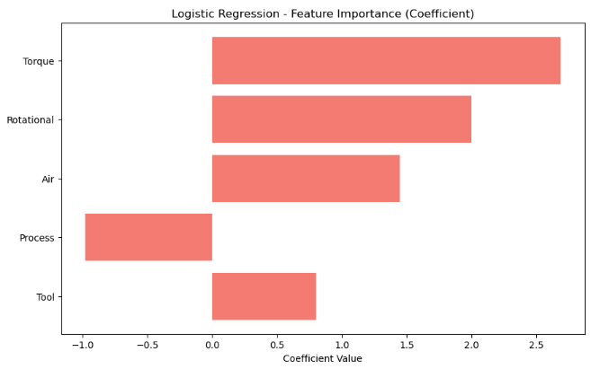
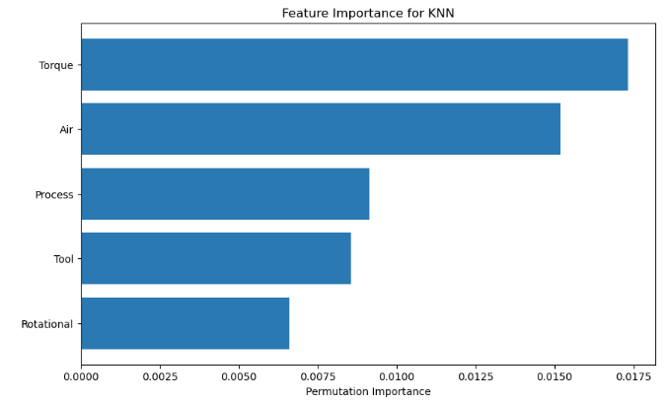
Feature Importance
Notes:
When tuning my parameters, I used Grid Search Cross Validation
The m

Slide 11
Summary
Best Recall:
Decision Tree (0.7541), which means it identifies the highest proportion of actual failures.
Best Overall Discrimination:
Random Forest has the highest AUC (0.97), indicating strong general classification ability and a good balance between precision and recall.
Recommendation
If maximizing recall is crucial (e.g., to catch as many failures as possible), the Decision Tree might be preferred.
For balanced performance with both high recall and overall accuracy, Random Forest is a strong choice.

Slide 12
Future Research
Expand to individual type of failure
Add probability of an event for each failure type

Slide 13
Thank You!

Slide 14
Questions?

